Slide 1

Computer Systems Fundamentals
H175 34
Lecture 4
Boolean Logic

Slide 2
What is Boolean Logic?
Boolean Logic is a branch of mathematics, dealing with rules for manipulating the two values true and false.
Boolean Logic is particularly relevant to computers as it is binary logic.
Deals with only two values
Can only be in one state at any given point in time
Can’t be between states
Time taken to jump between states is negligible
In other words, 1 = true and 0 = false!

Slide 3
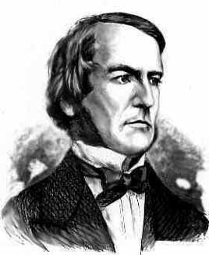
Why is it called Boolean Logic?
George Boole (1815 - 1864) was an English mathematician, the first to develop and describe a formal system of working with truth values. He was born in 1815 as the son of a shoemaker in Lincoln.

Slide 4
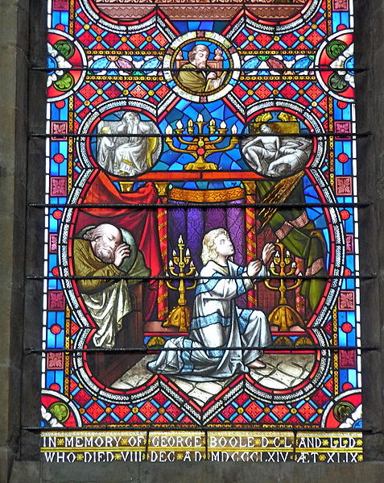
George Boole
Young George was taught Maths by his father, but by the age of eight, had outgrown his father's self-taught limits, and a tutor was hired to teach him Latin. At 16 he became an assistant teacher, at 20 he opened his own school.
He went on to become the first Professor of Mathematics at University College Cork, despite having no degree himself. His books The Mathematical Analysis of Logic (1847) and An Investigation of the Laws of Thought (1854) form the basis of present-day computer science and cybernetics.

Slide 5

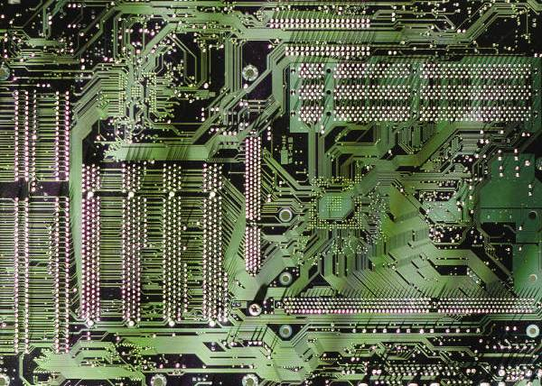
Boolean Expressions
A Boolean expression is any expression that evaluates out to true or false.
Is the expression 1+3 a Boolean expression?
What about 1+3=7?
Other examples -
x > 100
y < z
a = 100
w <> 10

Slide 6
Boolean Operators
There are a total of seven Boolean Operators that we use to evaluate problems.
Four of these are called Simple Logic Gates, the other three are Composite Logic Gates.
You will be given a set of binary values and asked to evaluate the answer depending on which gate is used.
In real life, Computer operations consist of many thousands of these logic gates, processing values and returning results at very high speeds.

Slide 7
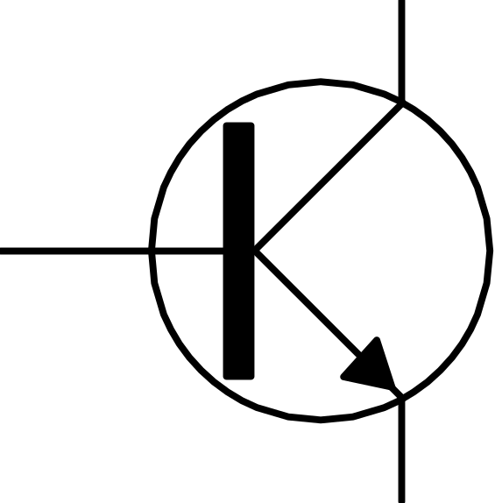
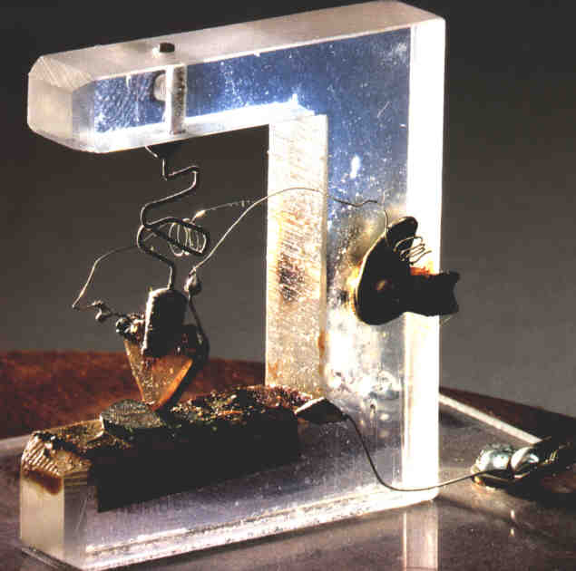
Boolean Logic Gates are built from transistors. These are tiny switches built of semiconductor material, usually silicon, but sometimes carbon molecules are used instead.
If the gate is open, no current can flow (0 state). If the gate is closed, current can flow (1 state).

Slide 8
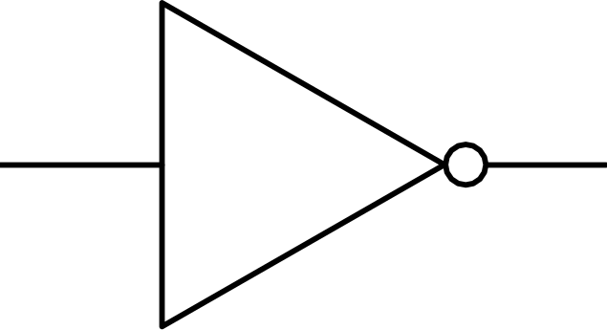

The Simple Gates - NOT
The simplest gate of all is the NOT gate, or INVERTER
All this does is reverse the value that went in.
The notation for a NOT gate looks like this -
Note the wee circle at the front of the NOT gate; this appears again later!

Slide 9
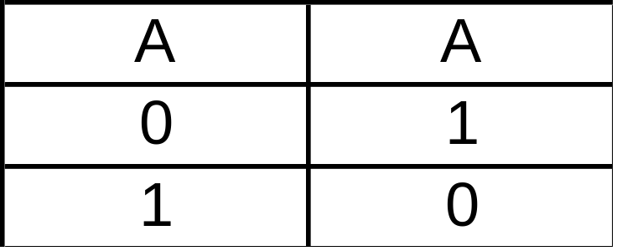

Truth Table - NOT
The Truth Table for a NOT gate looks like this
Example - If x = 10 and y = 15
NOT X > 0 is FALSE
NOT X > Y is TRUE
We write NOT A as A

Slide 10
We can show how a NOT works in Pascal using this routine -
VAR choice: char;
{more stuff here}
write (‘Enter a number from 0 - 6’);
readln (choice);
WHILE NOT (choice IN [‘0’..’6’]) THEN
BEGIN {to run error handling routine}
write (‘Error! Enter a number from 0 - 6!’);
readln (choice);
END{while};
We are actually running a check on what choice is not, as opposed to what it is!

Slide 11
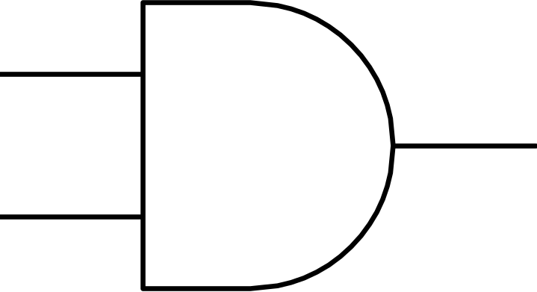
The Simple Gates - AND
The next gate is the AND gate. It always takes at least two inputs. All of the inputs have to be TRUE before the outcome is also TRUE.
The logic gate for an AND looks like this -

Slide 12
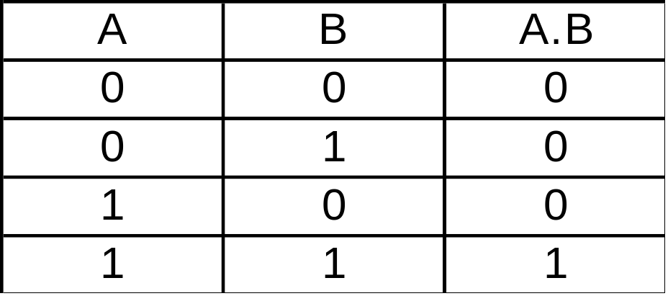
Truth Table - AND
The truth table for AND looks like this -
Example If x = 10, y = 15
(x > 0 AND y < 20) is TRUE
(x = 10 AND x > y) is FALSE
We write A AND B as A.B

Slide 13
We can show how an AND works in Pascal using this routine -
VAR BlindDateIsAttractive: boolean;
MoneyInPocket: integer;
{more stuff here}
IF (BlindDateIsAttractive = true) AND (MoneyInPocket > 100)
THEN
writeln (‘Let’s go to Poldinos!’)
ELSE
writeln (‘Lets go to Burger King.’);
{endif}
Both conditions have to be true before it will go on to do the statement after the THEN.

Slide 14
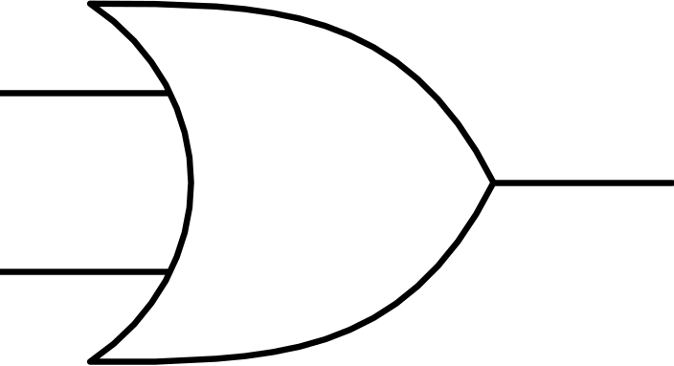
The Simple Gates - OR
The next gate is the OR gate. Again, it needs at least two inputs. But unlike the AND, only ONE of the inputs has to be TRUE before the outcome is also TRUE.
The logic gate for an OR looks like this -

Slide 15
Truth Table - OR
The truth table for OR looks like this -
Example - If x = 10 and y = 15
x > 0 OR x < 20 is TRUE
x = 10 OR x > y is TRUE
We write A OR B as A+B
DO NOT confuse this with A PLUS B!
A | B | A+B
0 | 0 | 0
0 | 1 | 1
1 | 0 | 1
1 | 1 | 1

Slide 16
We can show how an OR works in Pascal using this routine -
VAR DayOfWeek: String;
{more stuff here}
IF (DayOfWeek = ‘Friday’) OR (DayOfWeek = ‘Saturday’)
THEN
writeln (‘Let’s go out clubbing!’)
ELSE
writeln (‘Better stay home and study’);
{endif}
Only one of the conditions has to be true before it will go on to do the statement after the THEN.

Slide 17
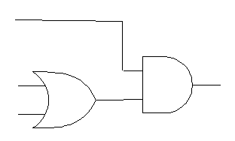

Let’s try some examples of Boolean Expressions.
Assume that x = 10, y = 15 and z = 20.
((x = 10) OR (y = 10)) AND (z > x)
z > x
X = 10
True
Y = 10

Slide 18
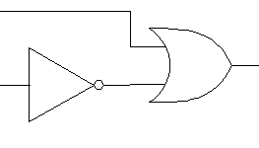
Assume that x = 10, y = 15 and z = 20.
(x = y) OR (NOT (x > z))
x = y
True
x > z

Slide 19
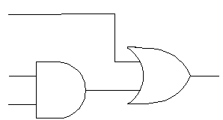

Assume that x = 10, y = 15 and z = 20.
((x = y) AND (x = 10)) OR (y > z)
y > z
x = y
False
x = 10

Slide 20
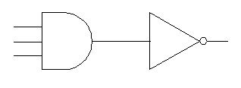
Assume that x = 10, y = 15 and z = 20.
NOT ((x > y) AND (z > y) AND (x < z))
x > y
z > y
x < z
True

Slide 21
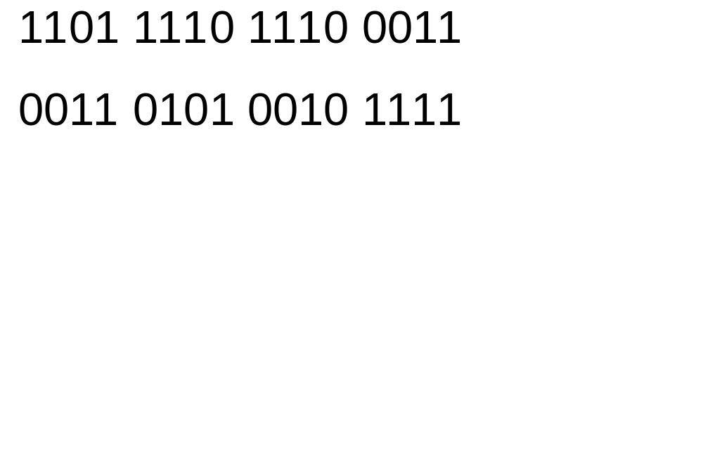
As part of your assessment material, you will be asked to perform logical operations between pairs of binary numbers.
Example - Perform a logical AND between the numbers
0001 0100 0010 0011

Slide 22

A logical OR between the same two numbers -
1101 1110 1110 0011
0011 0101 0010 1111
1111 1111 1110 1111

Slide 23
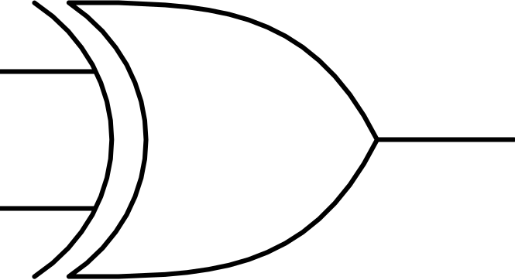
The next gate you need to be able to use is the XOR (exclusive OR) gate. Again, it needs at least two inputs. Unlike the AND and OR, however, it needs the inputs to be DIFFERENT from each other for a TRUE output.
If all of the inputs are the same, whether they are true or false, the output will be FALSE.
The logic gate for an XOR looks like this -
Note the double line at the base of this diagram, which always signifies an XOR gate!

Slide 24
Truth Table - XOR
The truth table for XOR looks like this -
Example - If x = 10, y = 15
(x > 0 XOR y < 20) = false
(x = 10 XOR x > y) = true
We write A XOR B as A + B
Sometimes you will see XOR written as EOR.
0 | 0 | 0
0 | 1 | 1
1 | 0 | 1
1 | 1 | 0

Slide 25

A logical XOR between the same two numbers -
1101 1110 1110 0011
0011 0101 0010 1111
1110 1011 1100 1100

Slide 26

In addition to the basic gates, there are also three composite gates - NAND, NOR and XNOR.
These comprise -
an AND immediately followed by a NOT
an OR immediately followed by a NOT
an XOR immediately followed by a NOT
To perform the logical operation, just treat the numbers as a normal AND, OR or XOR, then reverse the result!

Slide 27
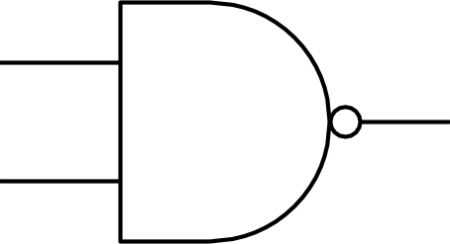
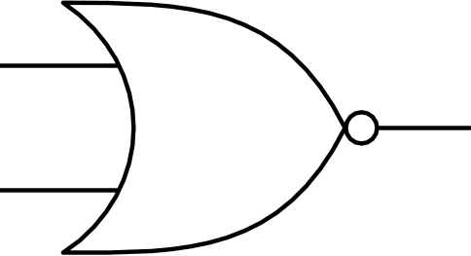
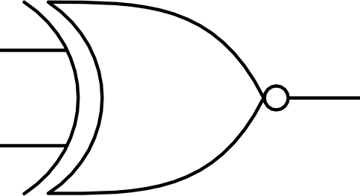
The Composite Gates
The logic gates for NAND, NOR and XNOR look like this -
The wee circle at the front always means that it is a composite gate!

Slide 28

The Truth Tables for NAND, NOR and XNOR -
0 | 0 | 1
0 | 1 | 1
1 | 0 | 1
1 | 1 | 0
0 | 0 | 1
0 | 1 | 0
1 | 0 | 0
1 | 1 | 0
A | B
0 | 0 | 1
0 | 1 | 0
1 | 0 | 0
1 | 1 | 1

Slide 29
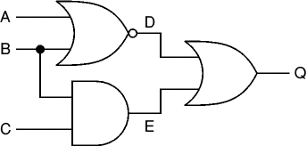
Logic gates are the basic building blocks of any computer system. Using combinations of logic gates, complex circuits can be constructed.
We usually call the output Q. Can you think why?

Slide 30
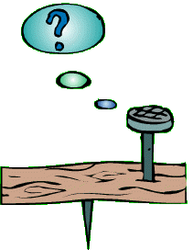
Any Questions?

Slide 31

Summary
NOT takes one input and reverses it.
AND requires all inputs to be 1 before it will return a 1.
OR requires only one input to be a 1 before it will return a 1.
XOR looks for differences in the inputs before it returns a 1.
NAND is the same as an AND followed by a NOT.
NOR is the same as an OR followed by a NOT.
XNOR is the same as XOR followed by a NOT.
Boolean Logic is particularly compatible with computers as both work in a bistable environment.

Slide 32


Credits
George Boole portrait courtesy of Roger Parsons
George Boole’s Window (Lincoln Cathedral) by Logicus, public domain photo
All other graphics © Focus Multimedia with open licence, unless stated
Subnetting example courtesy of wikipedia.org

